Slide 1
AMAZON E-COMMERCE
STRATEGIES FOR CUSTOMER BENEFITS AND REWARDS
Vikas Upadhyay
Date: 04/01/2025

Slide 2
AGENDA
Problem Statement
Approach
KPIs
Reports

Slide 3
Introduction
Amazon is a global leader in e-commerce, offering a vast range of products and services, including retail, cloud computing, and entertainment. Renowned for its customer-centric approach, innovative technologies, and efficient delivery systems, Amazon has revolutionized online shopping, making it convenient, reliable, and accessible worldwide.

Slide 4
PROBLEM STATEMENT
Amazon, an E-commerce company currently performing well. The stakeholders wish to maintain this level of performance and seek an improvement with new strategies.
Other than discounts and Prime membership perks, the company wants additional methods to identify and reward customers and enhance their shopping experience.

Slide 5
APPROACH
Revenue Distribution Analysis
Periodic And Geographical Analysis
Product Analysis
Customer Satisfaction Analysis
Customer Service Analysis

Slide 6
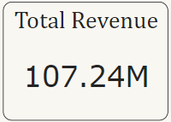
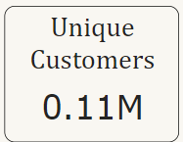
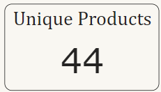
KEY PERFORMING INDICATORS
The total revenue generated
The total number of Unique Customers
Unique Products that are sold

Slide 7
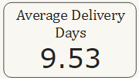
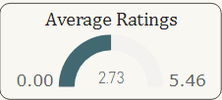
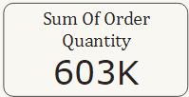
KEY PERFORMING INDICATORS
Average Delivery Time taken to deliver the products.
Overall Average Rating
Total Number of Order Quantity.

Slide 8
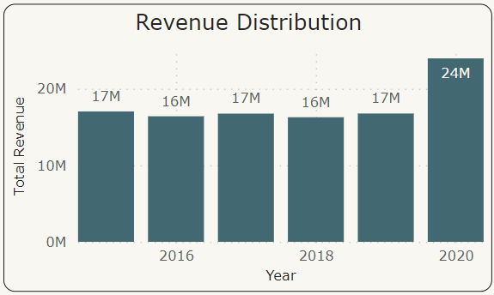
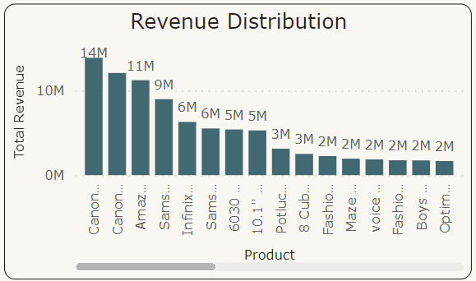
Revenue Distribution Analysis
With revenue distribution, we can understand which product contributing more to the revenue and also in which year revenue generated more.
Insights:
Revenue generated in the year 2020 is more compared to previous years.
Top revenue generated product is Canon EOS 600D 18MP DSLR Camera- Black with 14M sales.

Slide 9
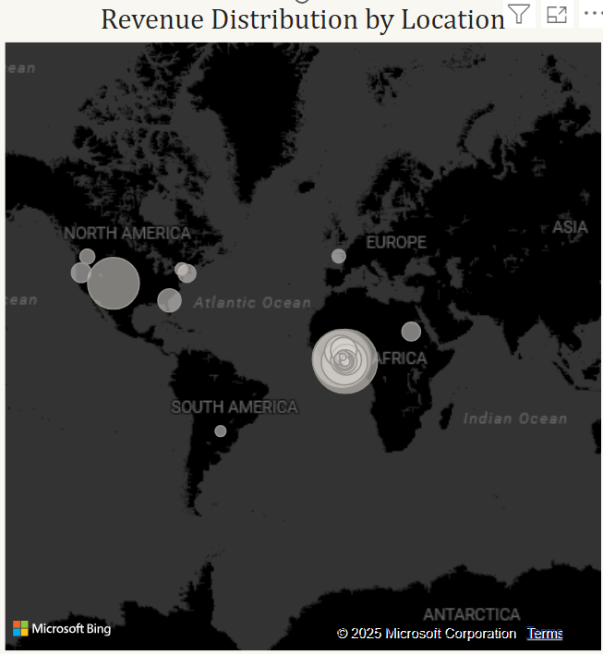
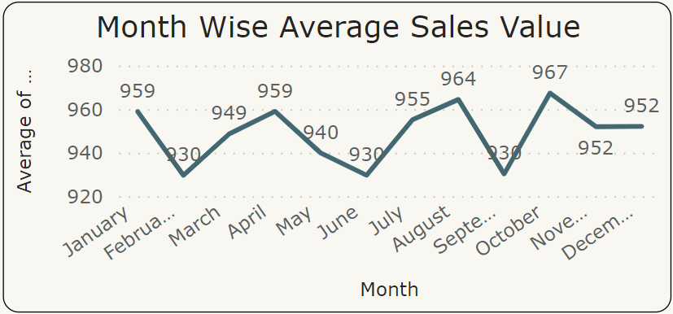
Periodic And Geographical Analysis
Periodic and Geographic analysis will help to devise target marketing and distribution strategies.
Insights:
The average sales value dropped for February, June and September.
North America and African regions are contributing more to revenue.
South America is the least revenue contributing region.

Slide 10
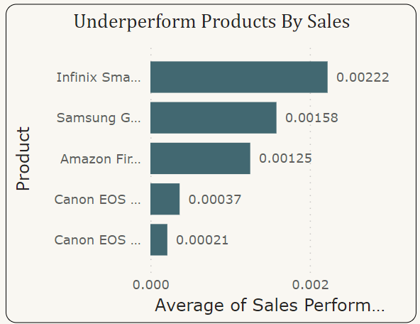
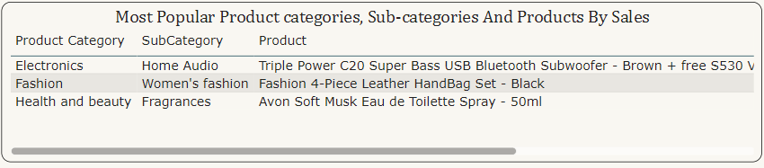
Product Analysis
In the product analysis, we can see the Most popular products and underperform products.
Insights:
We can see a clear distinction between the most popular, enjoying customer preference with high sales, and the underperforming products, indicating areas that may need targeted marketing efforts to enhance their overall sales.

Slide 11
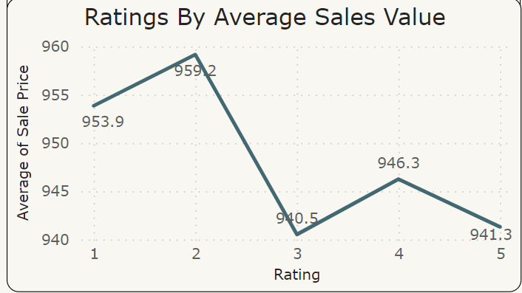
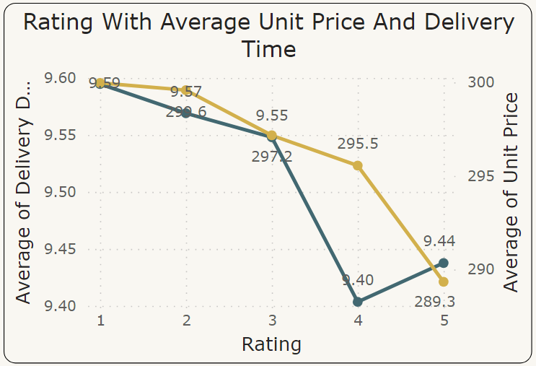
Customer Satisfaction Analysis
Customer satisfaction will help to understand how they are interested in the platform and how happy they are with shopping experience.
Insights:
Average rating given by customers is 2.73, which is above average.
Customers gave 4 & 5 rating for low unit price products
With less Delivery time, the ratings are very good compared to high delivery time.

Slide 12
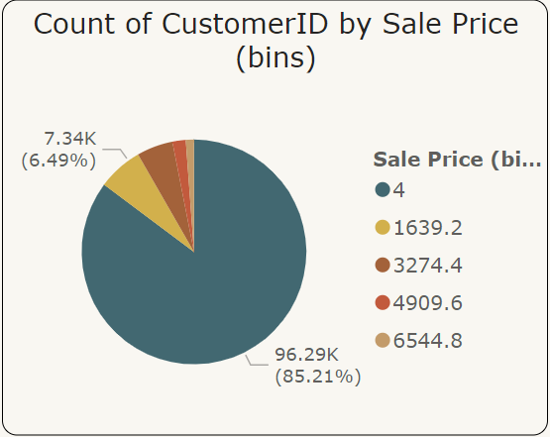
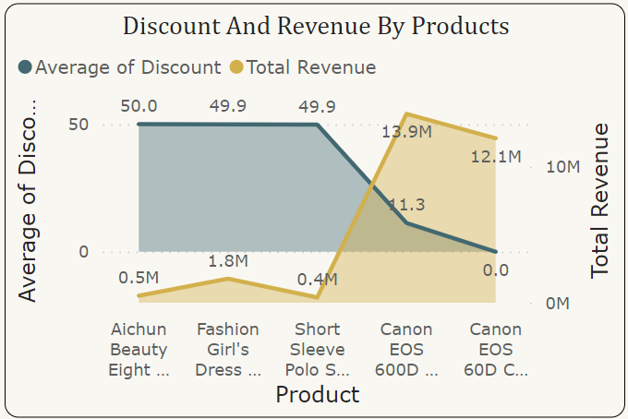
Customer Loyalty Program
Every company go for customer loyalty program to encourage customers engaging them to purchase more.
Insights:
Grouping the customers by their spending value, 85.21% customers spend low compared to others.
Despite their high revenue, these products have low average discount value. Giving discounts to these products will drive sales and revenue.

Slide 13
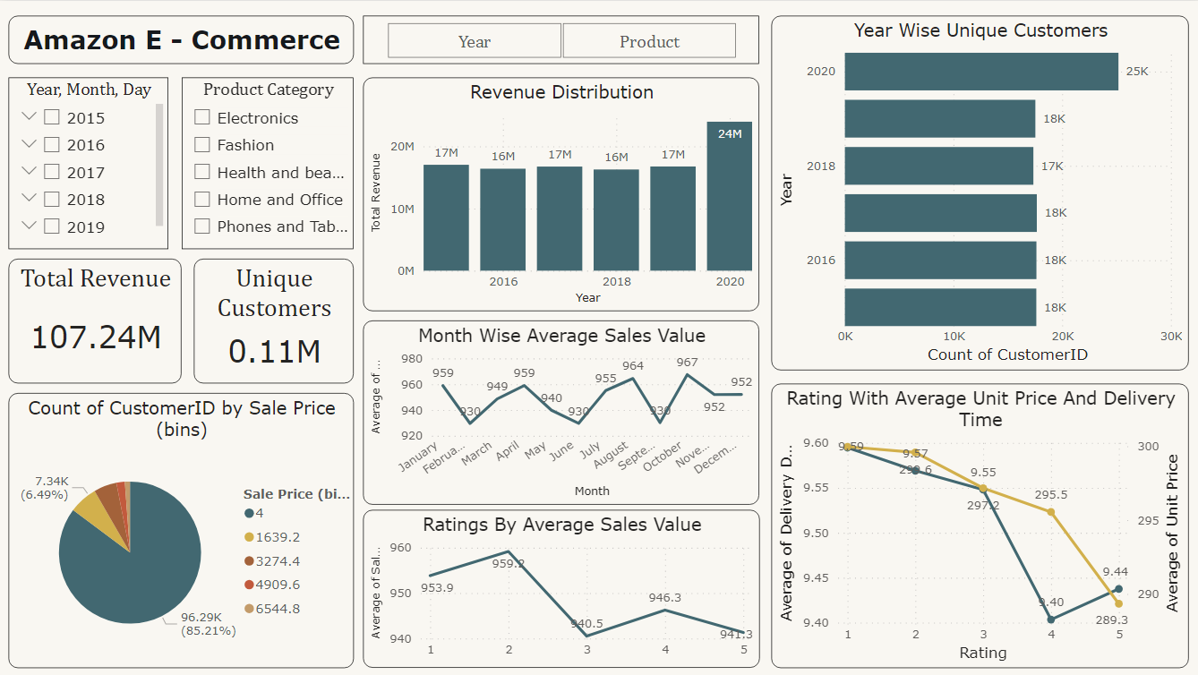
Report – Main Tab

Slide 14
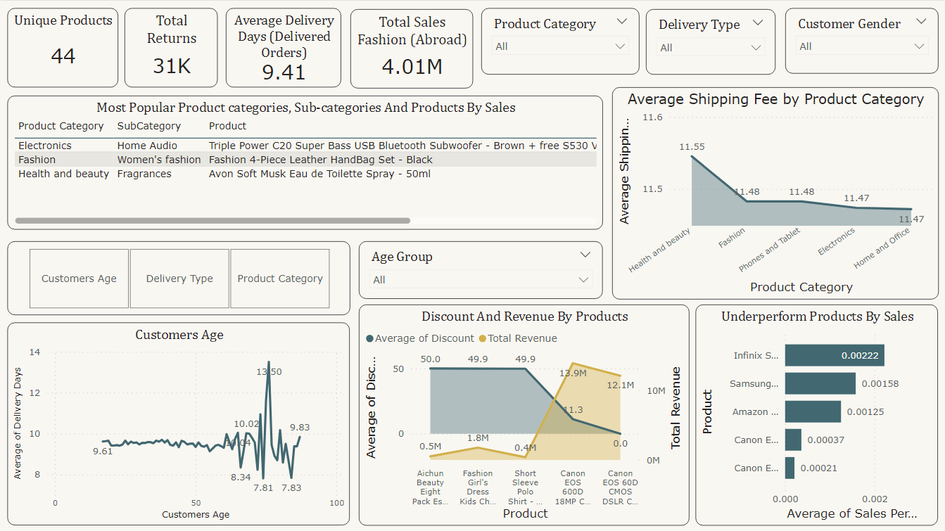
Product Tab

Slide 15
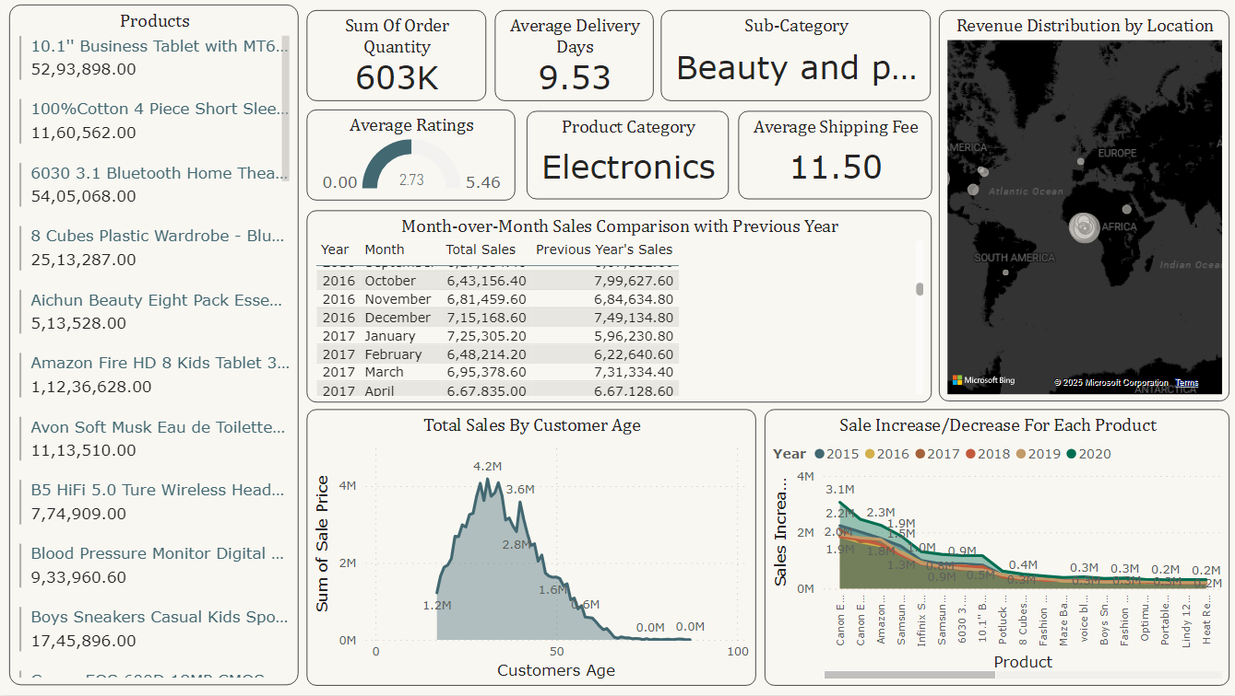
Individual Product Tab

Slide 16
Recommendation
Customer Retention: Introduce loyalty programs with exclusive perks for frequent buyers.
Enhanced Value Proposition: Expand Prime benefits and personalized offers.
Data-Driven Insights: Use data analytics to identify high-value customers and optimize campaigns.
Feedback Utilization: Act on customer feedback to improve service and product quality.
Location-Specific Offers: Focus on location-specific marketing and exclusive collaborations.
Innovative Engagement: Introduce gamification, dynamic pricing, and interactive rewards to boost customer interaction.

Slide 17
Conclusion
Amazon is performing well but needs to focus on maintaining its competitive edge and customer satisfaction.
Identifying high-value customers and providing them with targeted rewards can boost loyalty.
Leveraging data analytics and customer feedback will ensure continuous improvement and enhanced shopping experiences.
Expansion of Prime perks and personalized offerings will keep Amazon attractive to existing and new customers.

